Slide 1
CSE1006 – Blockchain and Cryptocurrency Technologies MODULE - 2
How Blockchain Achieves and How to Store and Use
Dr. Jayanthi.R

Slide 2
Content
Decentralization-Centralization vs. Decentralization-Distributed consensus
Consensus without identity using a blockchain,
Incentives, and proof of work
Simple Local Storage
Hot and Cold Storage
Splitting and Sharing Keys
Online Wallets and Exchanges
Payment Services
Transaction Fees
Currency Exchange Markets.

Slide 3
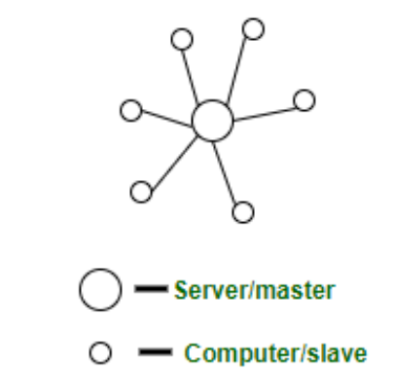
Decentralization-Centralization vs. Decentralization-Distributed consensus
CENTRALIZED SYSTEM:
Centralized systems are systems that use client/server architecture where one or more client nodes are directly connected to a central server.
This is the most commonly used type of system in many organizations where a client sends a request to a company server and receives the response.

Slide 4
Decentralization-Centralization vs. Decentralization-Distributed consensus
Example Wikipedia. Consider a massive server to which we send our requests and the server responds with the article that we requested. Suppose we enter the search term ‘junk food’ in the Wikipedia search bar. This search term is sent as a request to the Wikipedia servers (mostly located in Virginia, U.S.A) which then respond back with the articles based on relevance. In this situation, we are the client node, and Wikipedia servers are the central server.

Slide 5
Decentralization-Centralization vs. Decentralization-Distributed consensus
Characteristics of Centralized System
Presence of a global clock: As the entire system consists of a central node(a server/ a master) and many client nodes(a computer/ a slave), all client nodes sync up with the global clock(the clock of the central node).
One single central unit: One single central unit which serves/coordinates all the other nodes in the system.
Dependent failure of components: Central node failure causes the entire system to fail. This makes sense because when the server is down, no other entity is there to send/receive responses/requests.

Slide 6
Decentralization-Centralization vs. Decentralization-Distributed consensus
Characteristics of Centralized System
Presence of a global clock: As the entire system consists of a central node(a server/ a master) and many client nodes(a computer/ a slave), all client nodes sync up with the global clock(the clock of the central node).
One single central unit: One single central unit which serves/coordinates all the other nodes in the system.
Dependent failure of components: Central node failure causes the entire system to fail. This makes sense because when the server is down, no other entity is there to send/receive responses/requests.

Slide 7
Decentralization-Centralization vs. Decentralization-Distributed consensus
Advantages of Centralized System
Easy to physically secure
Dedicated resources (memory, CPU cores, etc)
More cost-efficient for small systems up to a certain limit
Quick updates are possible
Easy detachment of a node from the system.
Disadvantages of Centralized System
Highly dependent on network connectivity
No degradation of the system
Less possibility of data backup.
Difficult server maintenance.

Slide 8
Decentralization-Centralization vs. Decentralization-Distributed consensus
DECENTRALIZED SYSTEMS:
These are other types of systems that have been gaining a lot of popularity, primarily because of the massive hype of Bitcoin.
The basic idea of decentralization is to distribute control and authority to the peripheries of an organization instead of one central body being in full control of the organization.
In decentralized systems, every node makes its own decision.
The final behavior of the system is the aggregate of the decisions of the individual nodes.
Note that there is no single entity that receives and responds to the request.

Slide 9
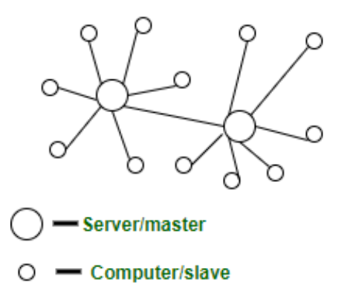
Decentralization-Centralization vs. Decentralization-Distributed consensus
This configuration produces several benefits for organizations, such as increased efficiency, expedited decision-making, better motivation, and a reduced burden on top management
The fundamental basis of blockchain is that no single central authority is in control, and, here we present examples of various Methods of decentralization and Routes to achieving this.

Slide 10
Decentralization-Centralization vs. Decentralization-Distributed consensus
Example – Bitcoin. Let’s take Bitcoin for example because it is the most popular use case of decentralized systems. No single entity/organization owns the bitcoin network. The network is a sum of all the nodes who talk to each other for maintaining the amount of bitcoin every account holder has.
Characteristics of a Decentralized System
Lack of a global clock: Every node is independent of each other and hence, has different clocks that they run and follow.
Multiple central units (Computers/Nodes/Servers): More than one central unit which can listen for connections from other nodes
Dependent failure of components: one central node failure causes a part of the system to fail; not the whole system

Slide 11
Decentralization-Centralization vs. Decentralization-Distributed consensus
The architecture of a Decentralized System
peer-to-peer architecture – all nodes are peers of each other. No one node has supremacy over other nodes
master-slave architecture – One node can become a master by voting and helping in coordinating a part of the system but this does not mean the node has supremacy over the other node which it is coordinating
Advantages of Decentralized System
The minimal problem of performance bottlenecks occurring – The entire load gets balanced on all the nodes; leading to minimal to no bottleneck situations
High availability – Some nodes(computers, mobiles, servers) are always available/online for work, leading to high availability
More autonomy and control over resources – As each node controls its own behavior, it has better autonomy leading to more control over resources

Slide 12
Decentralization-Centralization vs. Decentralization-Distributed consensus
Disadvantages of Decentralized System –
Difficult to achieve global big tasks – No chain of command to command others to perform certain tasks
No regulatory oversight
Difficult to know which node failed – Each node must be pinged for availability checking and partitioning of work has to be done to actually find out which node failed by checking the expected output with what the node generated
Difficult to know which node responded – When a request is served by a decentralized system, the request is actually served by one of the nodes in the system but it is actually difficult to find out which node indeed served the request.

Slide 13
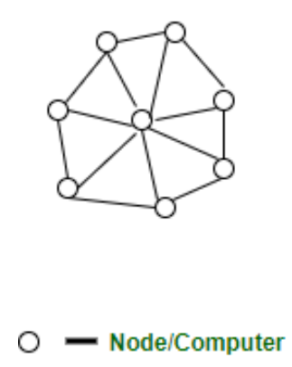
Decentralization-Centralization vs. Decentralization-Distributed consensus
3. DISTRIBUTED SYSTEMS:
A distributed system is a collection of computer programs that utilize computational resources across multiple, separate computation nodes to achieve a common, shared goal. Also known as distributed computing or distributed databases, it relies on separate nodes to communicate and synchronize over a common network.
These nodes typically represent separate physical hardware devices but can also represent separate software processes, or other recursive encapsulated systems.
Distributed systems aim to remove bottlenecks or central points of failure from a system.

Slide 14
Example :
Google search system. Each request is worked upon by hundreds of computers that crawl the web and return the relevant results. To the user, Google appears to be one system, but it actually is multiple computers working together to accomplish one single task (return the results to the search query).
Characteristics of Distributed System:
Resource sharing: A distributed system can share hardware, software, or data
Simultaneous processing: Multiple machines can process the same function simultaneously
Scalability: The computing and processing capacity can scale up as needed when extended to additional machines
Error detection: Failures can be more easily detected
Transparency: A node can access and communicate with other nodes in the system
The architecture of Distributed System –
peer-to-peer – all nodes are peers of each other and work towards a common goal

Slide 15
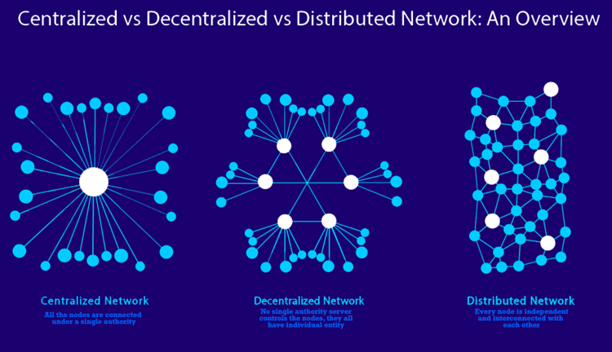
Advantages of Distributed System –
Low latency than a centralized system – Distributed systems have low latency because of high geographical spread, hence leading to less time to get a response
Disadvantages of Distributed System –
Difficult to achieve consensus
The conventional way of logging events by absolute time they occur is not possible here

Slide 16
Bitcoin Protocol on Decentralization
Who maintains the ledger of transactions?
Who has authority over which transactions are valid?
Who creates new bitcoins?
Who determines how the rules of the system change?
How do bitcoins acquire exchange value?
Aspects of Decentralization in Bitcoin
Peer-to-peer decentralized network
Open to anyone, low barrier to entry
Mining
Open to anyone, but the huge capital cost of infrastructure
Updates to Software
Core developers trusted by the community have the privilege

Slide 17
Why distributed Consensus Protocol?
Bitcoin Key Challenge
The key technical challenge of decentralized e-cash: distributed consensus
Reliability in distributed systems – Facebook, Google, Twitter, etc.,
Each piece of information must be recorded on several different nodes in this backend, and the nodes must be in sync with the overall state of the system
The reach of distributed consensus protocol is beyond traditional application
Distributed key-value store enable various application such as DNS, Public key directory, Stock trades, etc.,
There are n nodes that each have an input value. Some of these nodes are faulty or malicious.
A distributed consensus protocol has the following two properties:
● It must terminate with all honest nodes in agreement on the value
● The value must have been generated by an honest node

Slide 18
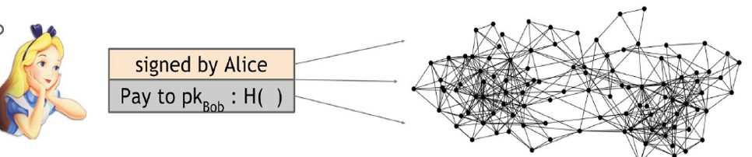
Bitcoin – Peer-to-Peer System
When Alice wants to pay Bob, what she actually does is broadcast a transaction to all of the Bitcoin nodes that comprise the peer‐to‐peer network
How consensus work in Bitcoin
At any given time,
All nodes have a sequence of blocks of transactions they have reached a consensus on
Each node has a set of outstanding transactions it heard about

Slide 19
What is a Consensus Algorithm?
Consensus: A generally accepted opinion or decision among a group of people.
Algorithm: A set of rules for accomplishing a task in a certain number of steps.
Combining the two, you get a set of rules and a number of steps for accomplishing a generally accepted decision among a group of people.

Slide 20
Why do we need them in Blockchain?
Consensus algorithms are put in place to ensure a group of people agrees that all transactions are validated and authentic.
Consensus algorithms ensure a network of random people can achieve consensus about transactions in the network.
People have to cooperate and grow accustomed to these new decentralized networks that have no central authority, unlike the governments, institutions, and businesses we are used to.
Consensus mechanisms secure a blockchain’s transactions by preventing the double-spending problem. At its very basic, double-spending is much like sending a photo to someone digitally.
You do not send the original picture, but a copy, and now two people have the same picture.
Imagine if someone could do this with cryptocurrencies.

Slide 21
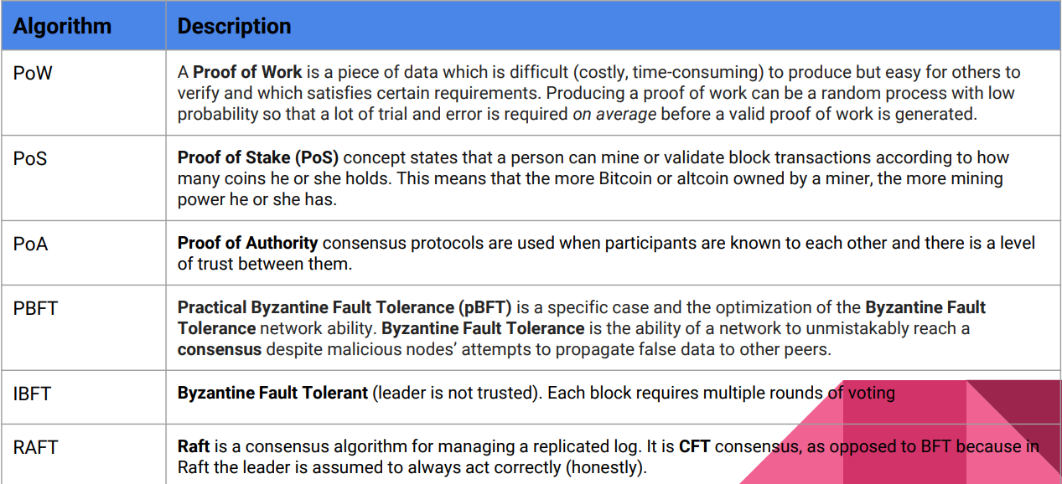
Few popular consensus algorithms

Slide 22
How Consensus Works in Bitcoin
The consensus protocol makes sure that every new block that is added to the Blockchain is the one and only version of the truth that is agreed upon by all the nodes in the Blockchain.
How does the consensus mechanism work?
What Is a Consensus Mechanism?
A consensus mechanism is a fault-tolerant mechanism that is used in computer and blockchain systems to achieve the necessary agreement on a single data value or a single state of the network among distributed processes or multi-agent systems, such as with cryptocurrencies.

Slide 23
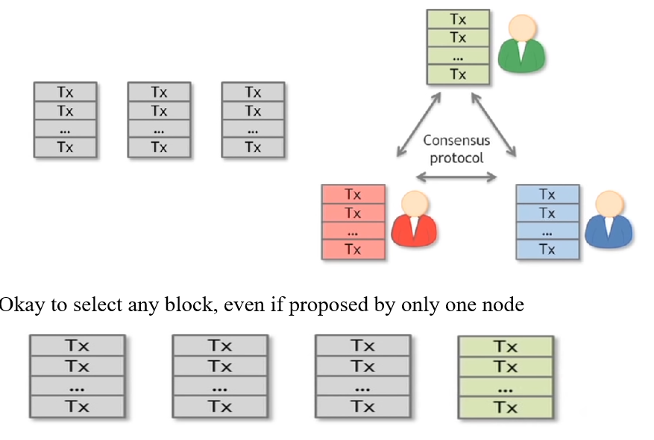
How Consensus Works in Bitcoin

Slide 24
Why Consensus is hard?
Nodes may crash
Nodes may be malicious
Network is imperfect
not all pairs of nodes connected
faults in the network
Latency --- no global time

Slide 25
Working of Consensus Algorithm
Assume – Alice a malicious node may be able to subvert this process
Stealing Bitcoin :
Can Alice simply steal bitcoins belonging to another user at an address she doesn’t control?
No. Even if it is Alice’s turn to propose the next block in the chain, she cannot steal other users’ bitcoins
Doing so would require Alice to create a valid transaction that spends that coin
This would require Alice to forge the owners’ signatures which she cannot do if a secure digital signature scheme is used
So as long as the underlying cryptography is solid, she’s not able to simply steal bitcoins

Slide 26
Working of Consensus Algorithm
Denial of service attack
Alice really dislikes Bob, Alice can then decide that she will not include any transactions originating from Bob’s address in any block that she proposes to get onto the blockchain
In other words, she’s denying service to Bob
While this is a valid attack that Alice can try to mount, luckily it’s nothing more than a minor annoyance
If Bob’s transaction doesn’t make it into the next block that Alice proposes, he will just wait until an honest node gets the chance to propose a block and then his transaction will get into that block

Slide 27
Working of Consensus Algorithm
Double spend attack
Alice is a customer of a website run by Bob, who provides some online service in exchange for payment in bitcoins
Let’s say Bob’s service allows the download of some software
Alice adds an item to her shopping cart on Bob’s website and the server requests payment
Then Alice creates a Bitcoin transaction from her address to Bob’s and broadcasts it to the network
Let’s say that some honest node creates the next block, and includes this transaction in that block
So there is now a block that was created by an honest node that contains a transaction that represents a payment from Alice to the merchant Bob

Slide 28
Transaction is a data structure that contains Alice’s signature, an instruction to pay to Bob’s public key, and a hash
This hash represents a pointer to a previous transaction output that Alice received and is now spending
That pointer must reference a transaction that was included in some previous block in the consensus chain
There are two different types of hash pointers here that can easily be confused
Blocks include a hash pointer to the previous block that they’re extending
Transactions include one or more hash pointers to previous transaction outputs that are being redeemed

Slide 29
How Alice Launch a double spending attack
The latest block was generated by an honest node and includes a transaction in which Alice pays Bob for the software download
Upon seeing this transaction included in the block chain, Bob concludes that Alice has paid him and allows Alice to download the software
Suppose the next random node that is selected in the next round happens to be controlled by Alice
Now since Alice gets to propose the next block, she could propose a block that ignores the block that contains the payment to Bob and instead contains a pointer to the previous block
Furthermore, in the block that she proposes, Alice includes a transaction that transfers the very coins that she was sending to Bob to a different address that she herself controls
This is a classic double‐spend pattern. Since the two transactions spend the same coins, only one of them can be included in the block chain
If Alice succeeds in including the payment to her own address in the block chain, then the transaction in which she pays Bob is useless as it can never be included later in the block chain.

Slide 30
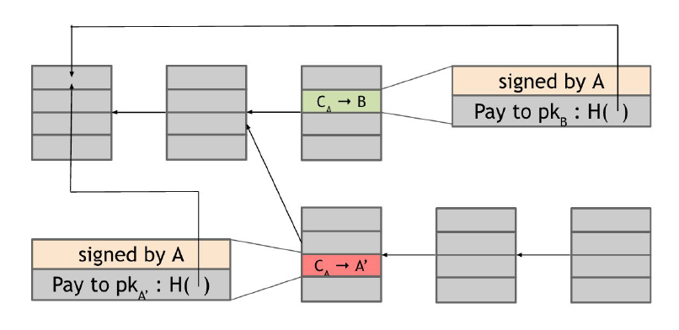
A double spend attempt

Slide 31
Is double spending going to succeed or not?
It depends on which block will ultimately end up on the long‐term consensus chain — the one with the Alice → Bob transaction or the one with the Alice → Alice transaction
What determines which block will be included? Honest nodes follow the policy of extending the longest valid branch, so which branch will they extend?
There is no right answer! At this point, the two branches are the same length — they only differ in the last block and both of these blocks are valid
The node that chooses the next block then may decide to build upon either one of them, and this choice will largely determine whether or not the double‐spend succeeds

Slide 32
Which of the two blocks is valid? The valid one is the one followed by next blocks inserted by other nodes. Honest nodes always extend the longest valid branch. But, which of these is the longest valid branch?
In practice, nodes often follow a heuristic of extending the block that they first heard about on the peer‐to‐peer network
But it’s not a solid rule, due to network latency, it could easily be that the block that a node first heard about is actually the one that was created second
So there is at least some chance that the next node that gets to propose a block will extend the block containing the double spend
Alice could further try to increase the likelihood of this happening by bribing the next node to do so
If the next node does build on the double‐spend block for whatever reason, then this chain will now be longer than the one that includes the transaction to Bob
At this point, the next honest node is much more likely to continue to build on this chain since it is longer
This process will continue, and it will become increasingly likely that the block containing the double‐spend will be part of the long‐term consensus chain
The block containing the transaction to Bob, on the other hand, gets completely ignored by the network, and this is now called an orphan block.

Slide 33
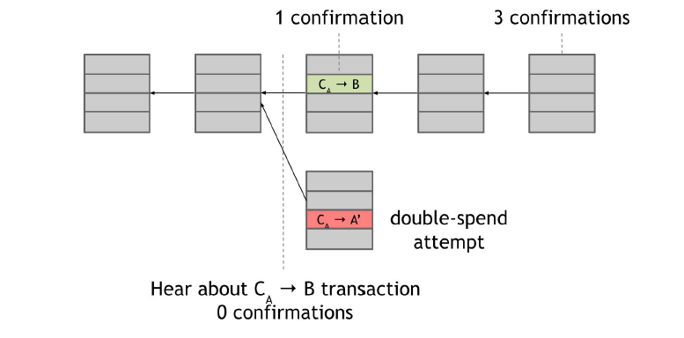
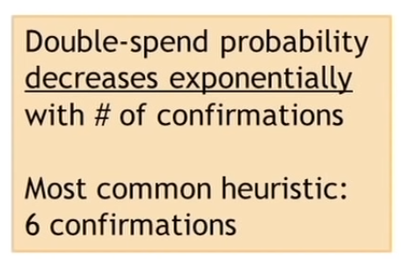
Bob-the Merchant Point of View

Slide 34
Understanding how Bob can protect himself from this double‐spending attack is a key part of understanding Bitcoin security
When Alice broadcasts the transaction that represents her payment to Bob, Bob is listening on the network and hears about this transaction even before the next block is created
If Bob was even more foolhardy than we previously described, he can complete the checkout process on the website and allow Alice to download the software right at that moment that’s called a zero‐confirmation transaction
This leads to an even more basic double-spend attack than the one described before
Previously, for the double‐spend attack to occur, we had to assume that a malicious actor controls the node that proposes the next block
But if Bob allows Alice to download the software before the transaction receives even a single confirmation on the blockchain, then Alice can immediately broadcast a double‐spend transaction, and an honest node may include it in the next block instead of the transaction that pays Bob.

Slide 35
How can Bob protect himself from a double-spending attack?
Bob can consider Alice’s transaction valid at different times:
0-confirmation transaction: Bob is listening to the Bitcoin network and can accept Alice’s payment as soon as he hears about the transaction. This leads to an even more basic double-spending attack than the one described before. If Bob allows Alice to access the service before the transaction receives even a single confirmation on the blockchain, then Alice can immediately make a double-spend transaction. And an honest node may include it in the next block instead of the transaction that pays Bob.
1-confirmation transaction: Bob accepts Alice’s transaction after the block is inserted into the blockchain as described in the previous paragraph.
3-confirmation transaction: Bob waits to see if the following blocks in the blockchain are attached to the block containing its transaction, before allowing Alice to access the service.

Slide 36
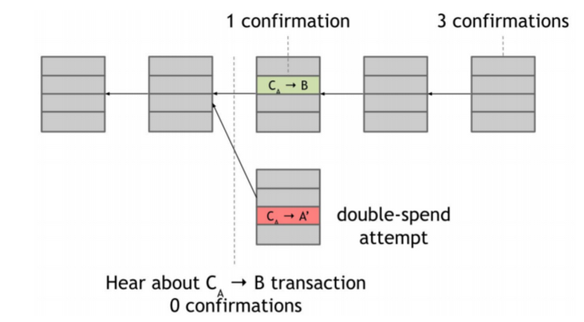

Slide 37
On the other hand, a cautious merchant would not release the software to Alice even after the transaction was included in one block, and would continue to wait
If Bob sees that Alice successfully launches a double‐spend attack, he realizes that the block containing Alice’s payment to him has been orphaned
He should abandon the transaction and not let Alice download the software
Instead, if it happens that despite the double‐spend attempt, the next several nodes build on the block with the Alice → Bob transaction, then Bob gains confidence that this transaction will be on the long‐term consensus chain.
In general, the more confirmations a transaction gets, the higher the probability that it is going to end up on the long‐term consensus chain
Recall that honest nodes’ behavior is always to extend the longest valid branch that they see
The chance that the shorter branch with the double spend will catch up to the longer branch becomes increasingly tiny as it grows longer than any other branch
This is especially true if only a minority of the nodes are malicious — for a shorter branch to catch up, several malicious nodes would have to be picked in close succession

Slide 38
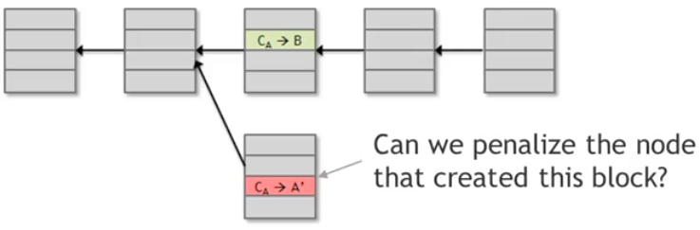
Incentives and Proof of work
Incentive to nodes
Assumption of honesty is problematic
We are unable to penalize the node that has cheated, because nodes don’t have identities
Reward the honest nodes that created all the blocks that end up on the long-term consensus chain
We don't have node identity, so we can't mail them cash to their home addresses, we can use BitCoins in order to incentivize the nodes to behave honestly

Slide 39
Incentive1: block reward
a node gets the block award regardless of whether it proposes a block with only valid transactions, or it behaves maliciously
The node will collect the reward only if this block ends up on the long-term consensus branch
The creation transaction also becomes valid only if it belongs to a long-term consensus branch

Slide 40
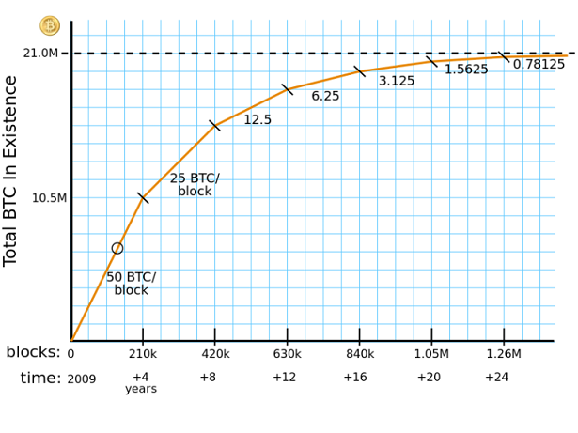

Slide 41
Incentive2 : Transaction Fees
The creator of any transaction can choose to make the output value of that coin less than the input value
Transaction value = Output value - Input Value
This transaction fee is purely voluntary
It is not mandatory to include a fee in a transaction, but as the block reward starts to run out, it will become almost mandatory for nodes to include a transaction fee in order to get a reasonable quality of service

Slide 42
Problems in bitcoin protocol
How can we pick a random node to insert the new block?
After introducing incentives, everyone probably wants to run a bitcoin node in order to get a reward
An adversary might try to create a whole bunch of Sybil nodes in order to try to subvert this consensus process

Slide 43
Blockchain Validator Selection
Different blockchain protocols adopt different methodologies for selecting the validator from available pool of nodes
PoW (Proof of Work) - Computing power
PoS (Proof of Stake) - Rich in the system
Proof of Activity - Hybrid
Proof of Elapsed Time
Proof of Burn

Slide 44
Hash Puzzle Problem Difficulty - Nonce
In order to add a block, the node that proposes it has to find a number: a nonce
This nonce concatenated with the hash of the previous block and the transactions Merkle Tree hash, must have an hash that falls into a small target space
The space is small in relation to the entire output space of the hash function
H(Nonce||hahs_prev_block_hash_transaction) ϵ { target_set}
Problem Difficulty
It must be moderately difficult to find a nonce that satisfies this required property, which is that hashing the whole block together including that nonce is going to result in a particular type of output
If the target space was just 1% of the overall output space, it would be necessary to try about 100 nonces before one gets lucky
The real target space is much smaller, so the attempt to find a correct hash will be many more

Slide 45
Proof of Work Properties
The proof-of-work function of an hash puzzle must be:
Difficult to compute
It is necessary to compute about 10²⁰ hashes to be able to insert a new block, so the size of the target space is only around 1/ 10²⁰ of the output space of the hash function
So only some nodes of the network with high computing power actively compete in the block creation process
This process of repeatedly trying and solving these hash puzzles is known as Bitcoin mining , and we call the participating nodes miners

Slide 46
Parameterizable cost
Always not a fixed cost for all time
The Bitcoin peer‐to‐peer network will automatically recalculate the target, that is the size of the target space as a fraction of the output space, every 2016 blocks
In other words, the recalculation of the target happens roughly every two weeks
Recalculation of the target in such a way that the average time between successive blocks produced in the Bitcoin network is about 10 minutes

Slide 47
Trivial to verify
It is trivial to verify that a node has computed proof of work correctly
Even if it takes a node, on average, 10²⁰ tries to find a nonce that makes the block hash fall below the target, that nonce must be published as part of the block
It is thus trivial for any other node to look at the block contents, hash them all together, and verify that the output is less than the target
Any node or any miner can instantly verify that a block found by another miner satisfies this proof‐of‐work property.

Slide 48
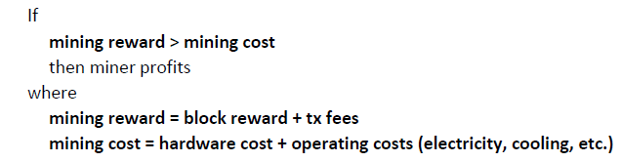
Cost of Mining
Mining Economics
The current difficulty level, finding a single block takes computing about 10²⁰ hashes and the block reward is about 6.25 Bitcoins, which is a sizable amount of money at the current exchange rate
The mining reward that the miner gets is in terms of the block reward and transaction fees
The miner asks himself how it compares to the total expenditure, which is the hardware and electricity cost

Slide 49
The hardware cost is a fixed cost whereas the electricity cost is a variable cost that is incurred over time
Another complication is that the reward that miners get depends upon the rate at which they find blocks, which depends on not just the power of their hardware, but on the ratio of their hash rate to the total global hash rate
A third complication is that the costs that the miner incurs are typically denominated in dollars or some other traditional currency, but their reward is denominated in bitcoin
So this equation has a hidden dependence on Bitcoin’s exchange rate at any given time
So far we’ve assumed that the miner is interested in honestly following the protocol, but the miner might choose to use some other mining strategy instead of always attempting to extend the longest valid branch
So this equation doesn’t capture all the nuances of the different strategies that the miner can employ
Actually analyzing whether it makes sense to mine is a complicated game theory problem that’s not easily answered

Slide 50
How Blockchain Achieves and How to Store and Use
Blockchain achieves consensus, security, and immutability through the use of cryptography, decentralized networks, and consensus algorithms.
A person named Alice wants to send some cryptocurrency to Bob. This transaction is broadcasted to the network where the nodes validate the transaction by solving complex mathematical problems, known as consensus algorithms.
Once the transaction is validated, it is added to a block, along with other transactions.
The block is then linked to the previous block, creating a chain of blocks, hence the name "blockchain".
This chain of blocks is stored across the nodes in the network, ensuring that there is no central point of control.
This decentralized architecture makes it nearly impossible for anyone to alter the data in the blockchain, providing immutability and security.

Slide 51
How Blockchain Achieves and How to Store and Use
To store and use cryptocurrencies, one needs a wallet which is essentially digital storage that holds the public and private keys needed to access the cryptocurrencies.
The private key is used to sign transactions and the public key is used to receive the transactions.
The person can use the wallet to send and receive cryptocurrencies, view the balance and transaction history, and manage their assets.

Slide 52
A network of nodes
What Is a Blockchain Node?
Blockchain nodes are the moderators that build the infrastructure of a decentralized network. Their primary function is to maintain the consensus of a blockchain's public ledger, which varies from one type of node to the next.
Routers, modems, switches, hubs, servers, and printers — basically, anything that has an IP address — can serve as a node.
“On the most basic level, a node is simply a device running the software of a specific blockchain.”

Slide 53
A network of nodes
A node is a computer connected to the Blockchain Network.
Node gets connected with Blockchain using the client. The client helps in validating and transmitting transactions on to the Blockchain.
When a computer connects to the Blockchain, a copy of the Blockchain data gets downloaded into the system and the node comes in sync with the latest block of data on the Blockchain.
The Node connected to the Blockchain which helps in the execution of a Transaction in return for an incentive is called Miners.

Slide 54
Simple local Storage
What is blockchain storage?
Blockchain storage is a way of saving data in a decentralized network, which utilizes the unused hard disk space of users across the world to store files.
The decentralized infrastructure is an alternative to centralized cloud storage and can solve many problems found in a centralized system.

Slide 55
Simple local Storage
Local storage in blockchain refers to the storage of data within a single node on the network, rather than being stored on the entire network.
An example of using local storage in a blockchain application would be storing user profiles on the node that the user is interacting with, instead of storing it on every node in the network.
This can increase the privacy and security of the user data, as well as reduce the storage requirements for each node on the network.

Slide 56
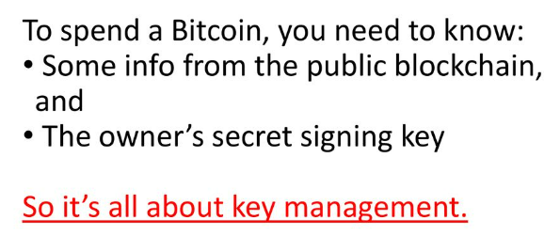
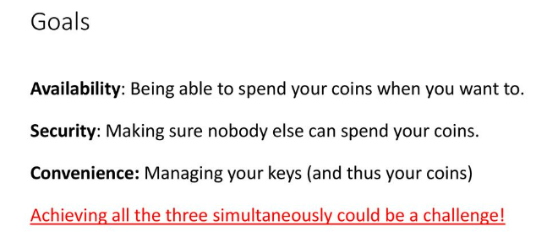
Simple local Storage

Slide 57
Simple local Storage
Simplest approach
Store the key in a file, on your computer or phone.
Very convenient.
As available as your device.
device lost/wiped ⇒ key lost ⇒ coins lost
As secure as your device.
device compromised ⇒ key leaked ⇒ coins stolen
Not adequate for most people.
Certainly not for companies/services.
So we see many methods to improve/change the tradeoff between convenience, security, availability, and privacy.

Slide 58
Wallet
After purchasing cryptocurrency, deciding how and where to store your assets is a very important step.
Cryptocurrencies run on a blockchain and therefore require digital storage systems called wallets.
Like a cash wallet, a crypto wallet allows you to hold and transfer funds.
Crypto wallets consist of public and private keys, which are strings of characters that allow holders to receive and transfer their crypto assets.

Slide 59
Wallet
What does wallet mean in Bitcoin?
“A Bitcoin wallet is a digital wallet storing the encryption material giving access to a Bitcoin public address and enabling transactions,”
What is a blockchain wallet called?
A blockchain wallet is a cryptocurrency wallet that allows users to manage different kinds of cryptocurrencies—for example, Bitcoin or Ethereum.
A blockchain wallet helps someone exchange funds easily.
Transactions are secure, as they are cryptographically signed.

Slide 60
Wallet software
A software wallet is like a digital bank account for your cryptocurrencies.
When you use a wallet, you are able to send, receive and manage your coins.
If storing your bitcoins locally, you’d typically use wallet software, which is software that keeps track of your coins, manages the details of your keys, and makes things convenient with the best user interface.
Wallet software is especially useful because you want to use a lot of different addresses with different keys associated with them.

Slide 61
Wallet software gives you a simple interface that tells you how much is in your wallet.
A software wallet is a program that you install on your computer. It might seem like you store your coins on your computer, but that’s not the case.
You should see your wallet as a sort of keychain that stores the keys that give you access to your coins.
A wallet generates a seed phrase (or recovery seed), which is usually a series of 12 or 24 randomly generated words.
Those words form a unique combination (like a password) that you can use to prove ownership of your coins. With these words, you can gain access to your coins from any kind of wallet

Slide 62
Wallet software
Note:
Software used when bitcoins are stored locally on a device
Wallet software -> Pros
software that: Keeps track of your coins.
Manage details of your keys.
Provides a nice user interface.

Slide 63
Wallet
Which software wallets are there?
There are different types of software wallets
Let us explain which types there are and what you could use them for.
Note: When you would like to download a software wallet on your PC or Mac, make sure to download it from the official website of the wallet provider. If you download it from a different website, the software could be infected with malware by hackers.

Slide 64
Software Wallet - Example
Exodus: supports bitcoin, litecoin, ether, XRP, and bitcoin cash
One of the best-known and most used software wallets is Exodus.
This wallet allows you to store and manage multiple coins simultaneously.
The wallet supports bitcoin, litecoin, ripple, and ether amongst other coins. For example various tokens on the Ethereum network (ERC-20 tokens).
The Exodus wallet combines functionality with ease of use.
The developers have paid a lot of attention to the graphic aspect, which reflects in the design. The interface looks clear and structured. And you can download it free of charge.

Slide 65
Software Wallet – Reference website
https://www.exodus.com/

Slide 66
Hot storage Cold storage
There are two types of storage options for crypto wallets, depending on preference: "hot" storage and "cold" storage.
Hot storage is an app or platform that is connected to the internet (online) and cryptocurrency network.
A hot wallet is easy to use on an exchange and is meant for everyday cryptocurrency transactions.
It is used to send and receive cryptocurrency with a few clicks on the phone or computer

Slide 67
Hot storage Cold storage
Cold wallets otherwise known as Cold Storage, are responsible for storing private keys in an offline environment.
Cold storage is stored offline, often through a physical device such as a thumb drive.
Crypto transactions with cold wallets generally involve a signing process.
Steps :
The transaction in the cold wallets starts online and then shifts to the offline process and after completion of the signing process, the complete information of the transaction goes back to an online network.
Cold Wallets have options such as hardware wallets and paper wallets.

Slide 68
How to store cold information?
Information stored in the device, device locked in a safe
2nd Method: Brain wallet, encrypt info under passphrase that user remembers - online guessing – offline guessing; password cracking – random 80-bit number- turning that number into a passphrase in such a way that different numbers result in different passphrases
3rd Method: Paper wallet, print info on a paper and lock the same - Typical paper wallets encode both the public and private keys in two ways: as a two-dimensional barcode and in base-58 notation
4th Method: Tamper-proof device, the device will sign things for you, but don’t disclose keys - put the key into the device or the device generates the key -One advantage: if the device is lost or stolen we’ll know it, and the only way the key can be stolen is if the device is stolen. This is different from storing your key on a laptop

Slide 69
Hardware Wallets are designed to be theft-proof so that even when plugged into, the computer funds cannot be stolen.
Paper wallets function similarly to hardware wallets however paper wallets are pieces of paper that contain a public wallet address and a private key.
It is found that cold wallets are expensive and they can store only selected cryptocurrencies others they don’t store.
Both hot and cold storage systems offer individuals access to their digital funds, but they differ in user experience and security levels.
Which option is right for you is a matter of personal choice.
The right answer may be a combination of the two options, depending on what you are looking to do with cryptocurrency in both the long and short term

Slide 70
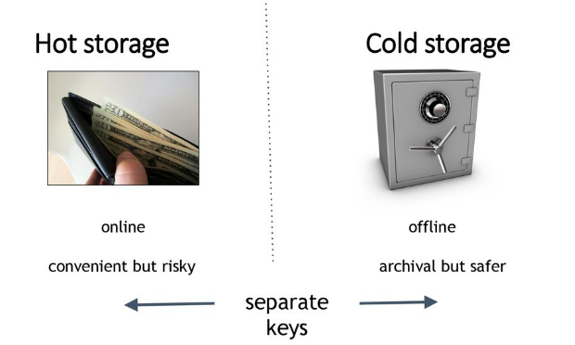
Hot storage Cold storage

Slide 71
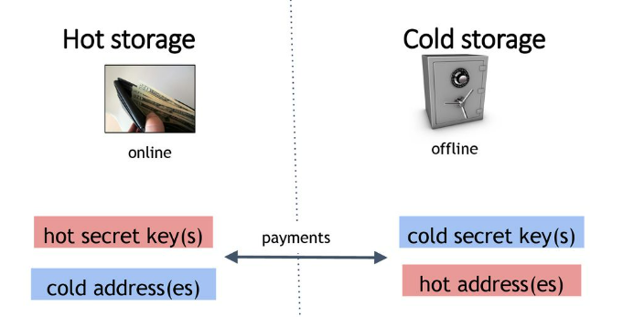
Hot storage Cold storage

Slide 72
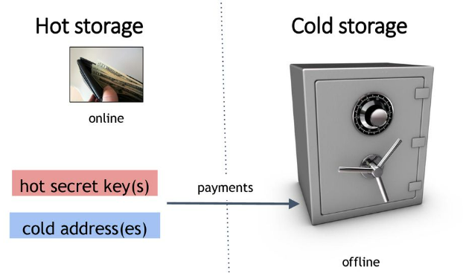
Hot storage Cold storage

Slide 73
Hot storage Cold storage
Problem:
Want to use a new address (and key) for each coin sent to cold? But how can a hot wallet learn new addresses if the cold wallet is offline?
Awkward solution:
Generate a big batch of addresses/keys, and transfer them to hot beforehand
Better solution:
Hierarchical wallet

Slide 74
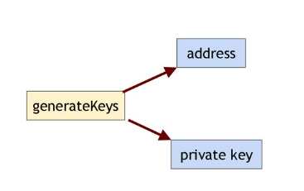
Hot storage Cold storage
Regular key generation:

Slide 75
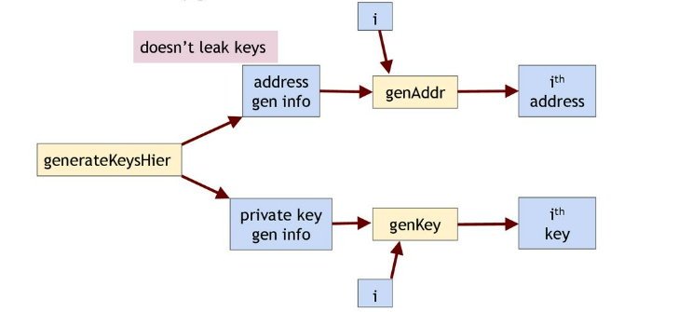
Hot storage Cold storage
Hierarchical key generation:

Slide 76
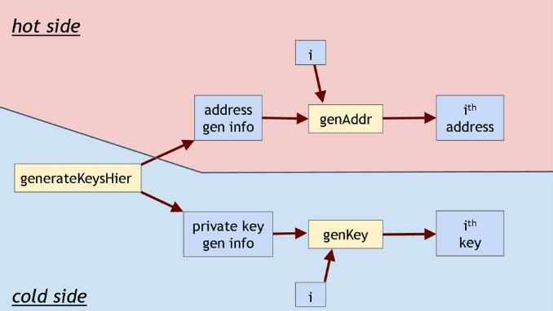
Hot storage Cold storage
Hierarchical key generation:

Slide 77
Hot storage Cold storage
Hierarchical key wallets:
The cold side creates and saves private key and address generation information.
It does a one-time transfer of the latter to the hot side.
The hot side generates a new address sequentially every time it wants to send coins to the cold side.
When the cold side reconnects, it generates addresses sequentially and checks the blockchain for transfers to those addresses until it reaches an address that hasn’t received any coins.
It can also generate private keys sequentially if it wants to send some coins back to the hot side or spend them some other way.

Slide 78
Hot storage Cold storage
For hierarchical key generation, we’ll need two other random values ​ k and ​ y
we have two levels of security, with the hot side being at a lower level.
If the hot side is compromised, the unlinkability property that we just discussed will be lost, but the private keys (and the bitcoins) are still safe.
In general, this scheme supports arbitrarily many security levels --- hence “hierarchical” --- although we haven’t seen the details.
This can be useful, for instance, when there are multiple levels of delegation within a company.

Slide 79
Hot storage Cold storage
The different ways in which cold information can be stored — whether one or more keys, or key-generation info ..
The first way is to store it in some kind of device and put that device in a safe. It might be a laptop computer, a mobile phone or tablet, or a thumb drive.
The important thing is to turn the device off and lock it up, so that if somebody wants to steal it they have to break into the locked storage.

Slide 80
Hot storage Cold storage
Brain wallet​ .
The second method we can use is called a brain wallet. This is a way to control access to bitcoins using nothing but a secret passphrase.
This avoids the need for hard drives, paper, or any other long-term storage mechanism.
This property can be particularly useful in situations where you have poor physical security, perhaps when you’re traveling internationally.
The key trick behind a brain wallet is to have a predictable algorithm for turning a passphrase into a public and private key.
For example, you could hash the passphrase with a suitable hash function to derive the private key, and given the private key, the public key can be derived in a standard way.

Slide 81
Hot storage Cold storage
Further, combining this with the hierarchical wallet technique we saw earlier, we can generate an entire sequence of addresses and private keys from a passphrase, thus enabling a complete wallet.
An adversary can also obtain all private keys in a brain wallet if they can guess the passphrase.
As always in computer security, we must assume that the adversary knows the procedure you used to generate keys, and only your passphrase provides security.
So the adversary can try various passphrases and generate addresses using them; if he finds any unspent transactions on the blockchain at any of those addresses, he can immediately transfer them to himself.
The adversary may never know (or care) who the coins belonged to and the attack doesn’t require breaking into any machines.
Guessing brain wallet passphrases is not directed toward specific users, and further, leaves no trace.

Slide 82
Hot storage Cold storage
Paper wallet​ .
The third option is called a paper wallet.
We can print the key material to paper and then put that paper into a safe or secure place.
The security of this method is just as good or bad as the physical security of the paper that we're using.
Paper wallets encode both the public and private key in two ways: as a 2D barcode and in base 58 notation.
Just like with a brain wallet, storing a small amount of key material is sufficient to re-create a wallet.

Slide 83
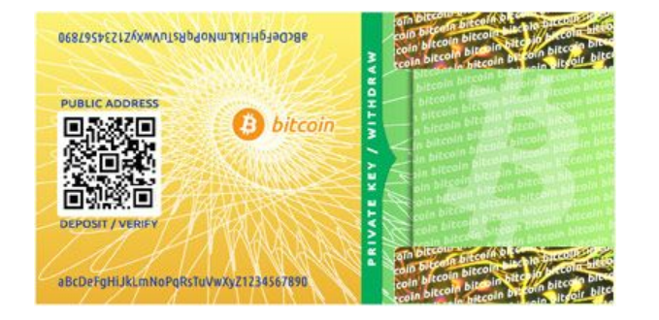
Hot storage Cold storage
A Bitcoin paper wallet ​ with the public key encoded both as a 2D barcode and in base 58 notation.​​ Observe that the private key is behind a tamper-evident seal.

Slide 84
Tamper-resistant device.​
The fourth way that we can store offline information is to put it in some kind of tamper-resistant device.
Either we put the key into the device or the device generates the key;either way, the device is designed so that there's no way it will output or divulge the key.
The device instead signs statements with the key, and does so when we, say, press a button or give it some kind of password.
One advantage is that if the device is lost or stolen we'll know it, and the only way the key can be stolen is if the device is stolen.
This is different from storing your key on a laptop.
In general, people might use a combination of four of these methods in order to secure their keys.
For hot storage holding large amounts of bitcoins, people are willing to work pretty hard and come up with novel security schemes in order to protect them, and we'll talk a little bit about one of those more advanced schemes in the next section

Slide 85
Hot storage
Pros:
Hot storage is online and easy to use and they require no physical storage and no transition from offline to online for the transaction.
Hot wallets are accessible as they can be traded from hands-on devices.
These wallets can accept various types of tokens and are ideal for traders and users with a good portfolio.
These wallets are available for free and can be created within a minutes.

Slide 86
Hot storage
Cons:
Security is an issue, therefore, storing a large number of digital assets in a hot wallet is not advisable.
It leaves your funds exposed to hackers to potential security threats such as cyber theft.
Another issue is the security of the private key, which is stored on the internet and the wallet browser.

Slide 87
Cold storage
Pros:
Cold wallets have a large storage capacity.
Most respected exchanges store the majority of the funds in the offline mode in cold storage.
Stealing from cold wallets is a bit difficult as they require physical possession or access to cold wallets.
Most cold wallets are encrypted with pin protection thus providing an extra layer of security.

Slide 88
Cold storage
Cons:
Cold wallets are less convenient than hot wallets because they require power and then to be connected to the internet.
These wallets are a bit expensive if someone wants to invest in crypto he also invests in these cold wallets to secure their funds.
These wallets are not suitable for trading online purchasing.
These wallets do not accept as many cryptocurrencies as hot wallets do.

Slide 89
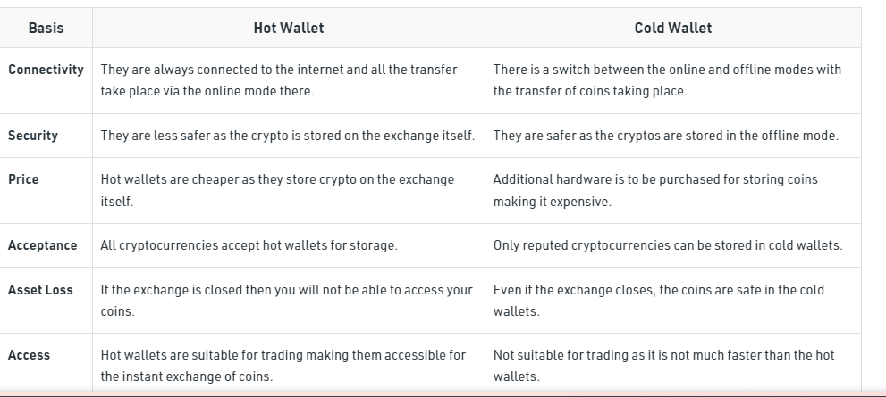
Hot Wallet vs Cold Wallet

Slide 90
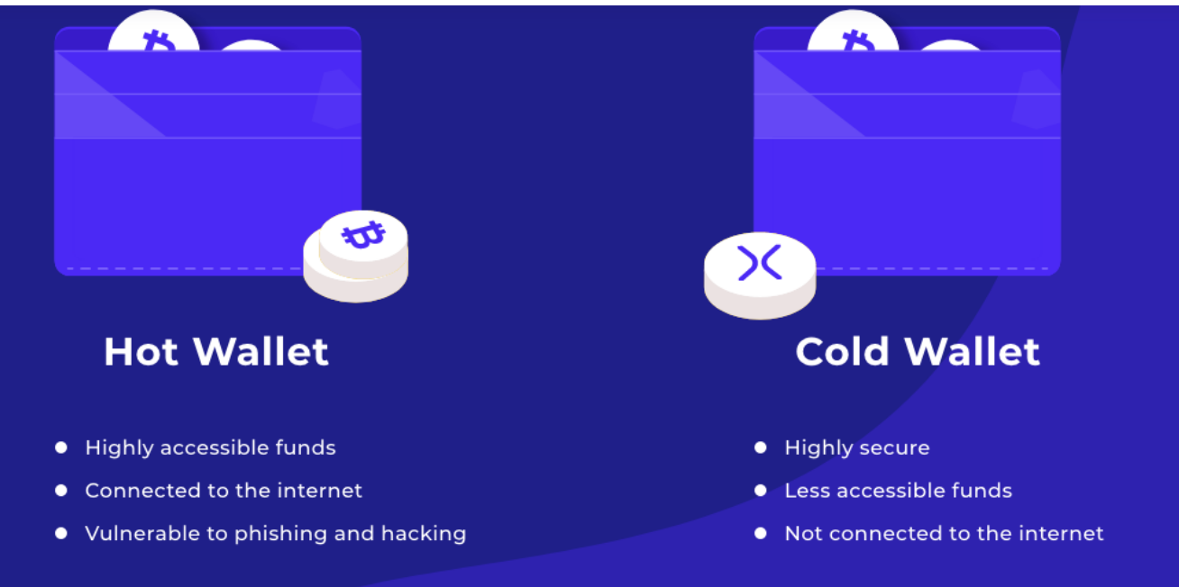
Hot storage Cold storage

Slide 91
Hot storage Cold storage – Example
A real-time scenario for hot and cold storage can be seen in the context of cryptocurrency trading.
The private keys for an individual's cryptocurrency assets can be stored in a hot wallet, which is easily accessible and connected to the internet for fast trades and transfers.
On the other hand, the majority of an individual's cryptocurrency assets can be stored in a cold wallet, which is offline and physically secure to protect against hacking and other cyber threats.
The cold storage serves as a more secure long-term storage solution, while the hot wallet is used for more immediate transactions.
profjai14@gmail.com
Example for hot and cold storage
A practical example of hot and cold storage can be seen in the management of a company's financial assets. The company's operating funds, which are needed for day-to-day transactions and paying bills, can be kept in a hot storage account, such as a checking account, that is easily accessible and connected to the internet. On the other hand, the company's savings and long-term investment funds can be kept in a cold storage account, such as a savings account or a money market fund, which is offline and physically secure to protect against hacking and other cyber threats. The cold storage serves as a more secure long-term storage solution, while the hot storage is used for more immediate financial needs.
Regenerate response

Slide 92
Hot storage Cold storage – summary
Storing bitcoins on your computer is like carrying money around in your wallet or your purse. This is called hot storage. It’s convenient but also somewhat risky.
In contrast, cold storage is offline.
It’s locked away somewhere, it’s not connected to the Internet.
So cold storage is safer and more secure, but of course not as convenient as hot storage

Slide 93
Encoding Keys: Base 58 and QR Codes
What is the meaning of Base58?
An encoding method that converts cryptocurrency addresses into ASCII text that can be manually copied without making mistakes. Base58 uses all the numeric and alphabetic characters except zero, upper case O, lower case L and the digit 1, which are error-prone character pairs (0 is confused with O, and I with 1).
To spend or receive bitcoins, you also need a way to exchange an address with the other party—ie: the address to which bitcoins are to be sent.
Two main methods are used to encode addresses so that they can be communicated from receiver to spender:
text string
QR code.

Slide 94
Text string method
To encode an address as a text string, we take the bits of the key and convert them from a binary number to a base-58 number.
Then we use a set of 58 characters to encode each digit as a character, called base-58 notation.
Why 58? Because that’s the total number of available uppercase letters, lowercase letters, as well as digits that can be used as characters.
A few might be similar and confusing but look like another character

Slide 95
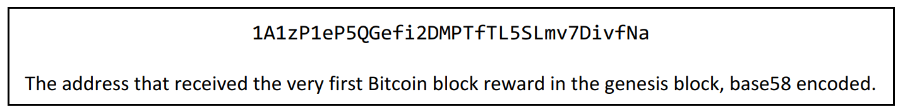
Text string method
For example, the capital letters “O” and zero are both removed because they look too much alike.
Few are removed from the list.
This allows encoded addresses to be read out over the phone or read from printed paper and typed in, should be necessary.
Such manual methods of communicating addresses can be avoided through such methods as QR codes.

Slide 96

QR Codes
The second method for encoding a Bitcoin address is as a QR code, a simple kind of two-dimensional barcode.

Slide 97
QR Codes
The advantage of a QR code is that you can take a picture of it with a smartphone, and wallet software can automatically turn the barcode into a sequence of bits that represents the corresponding Bitcoin address.
For example, the check-out system might display a QR code and you can pay with your phone by scanning the code and sending coins to that address. It is also useful for phone-to-phone transfers.

Slide 98

Example
Encoding addresses
Encode as a text string: base58 notation
ABCDEFGHJKLMNPQRSTUVWXYZabcdefghijkmnopqrstuvwxyz
or use the QR code

Slide 99
Vanity addresses
What is a Vanity Address?
Vanity addresses, or vanity addresses, are cryptocurrency addresses personalized(custom-made) and created in respect of a series of parameters given by the users of said addresses.
The aim of making them more personal and easily identifiable, but without giving up the security they provide.
In Bitcoin you can find different types of addresses, including custom addresses, also known as Vanity addresses.
The vanity addresses or Bitcoin vanity addresses they are normal addresses, with the same functionality as any other, they only contain a custom alphanumeric character string, a message, or a special word for its owner.

Slide 100
Vanity addresses
The standard addresses that are generated in the wallets are composed of randomly ordered alphanumeric characters, without any special order or meaning.
However, today, there is the ability to personalize these same addresses and add a special touch, either through a name, a brand, a special word, or a slightly more complete message.

Slide 101
How are Vanity Addresses generated?
The process for generating a vanity address is exactly the same as generating a normal address, generating a private key, from which the public key will be derived.
Then, from that public key a Bitcoin address will be generated, which will be verified to see if it meets the vanity pattern that is being sought. If so, it would result in a custom address that meets the requirements.
Otherwise, it would be necessary to carry out the entire process again. This will be repeated until the desired address is found.
Generally, this process is repeated several hundred or millions of times, until the addresses with the desired pattern are found.
Once the address is found, the user will have a "vanity address", being able to control it in the same way that any normal Bitcoin address is operated.

Slide 102
Vanity addresses
Ways to generate a vanity address
There are 2 methods by which vanity addresses can be generated.
The safe method would be to generate them personally and privately, using computer equipment with the appropriate programs.
Although to carry out this process it is necessary to have a certain degree of computer and programming knowledge.
The second method is much simpler but also less secure and reliable.
It consists of using some type of online service to generate these addresses, through which you would have a vanity address very quickly since these services generally have a lot of processing power.

Slide 103
Vanity addresses
But, at the same time, there is a risk that the owners of these services keep the private key that was generated with the address.
Therefore, we would not be the only ones who have the private key associated with the vanity address.
This represents a very serious security breach.
Online services
To generate a vanity address, you can use external online services, that is, third-party services that offer the possibility of generating these addresses in a personalized way and appropriate to our needs.
Many of these services generate vanity addresses for free or at a very low cost.
However, as already mentioned above, letting a third party get involved in generating your address that we are going to use is extremely dangerous, it could mean that said user also keeps the private keys associated with the created address and get hold of all money deposited at that address. Do not use this form of generation if not as an educational action.

Slide 104
Vanity addresses
However, as already mentioned above, letting a third party get involved in generating the address that we are going to use is extremely dangerous, ie: the user also keeps the private keys associated with the created address and gets hold of all money deposited at that address.
Do not use this form of generation if not as an educational activity.

Slide 105
Vanity addresses
Scripts
To generate a vanity address in a safe, private, and personal way, you can use VanityGen. Which is an open-source vanity address generator where you will have control of the generation. You will need a minimum of computer knowledge.
VanityGen allows you to create vanity addresses without an internet connection, and although its process can be very slow, it is the safest way to obtain this type of address.
Since nobody else will know or have access to the private key, and therefore, the funds deposited in it will be safe.
However, according to the pattern or structure of the management that is desired, it will be the difficulty of the generation process, which can take days or even weeks.

Slide 106
Vanity addresses
That is, depending on the number of letters that you want to obtain in the address, the generation process will be very fast or very delayed.
Thus, with each character that is added, the difficulty of the generator finding the desired pattern will increase.
For example, if you want to generate an address that contains the word 1Bet, this pattern is appended in the VanityGen input data.
The generator will then begin the process of finding a valid address that meets the established pattern.
Once found, it will give a result similar to this:

Slide 107
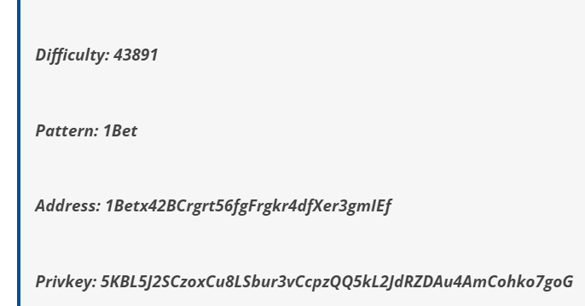
Vanity addresses
Where it specifies the difficulty of the process, the established pattern, the generated custom address, and the associated private key.
Keep in mind that, in addition to the difficulty of the pattern, in the generation of a vanity address, the power and speed of your equipment also have a significant influence.
So for the creation of this type of address, it is recommended to use graphics processing equipment, known as GPU, since these teams have a much higher processing capacity than conventional CPUs.

Slide 108
Splitting and Sharing Keys
Current key storage schemes
Problem: single point of failure
Trivial solution: make multiple copies or backup
Advantage: Availability improves
Disadvantage: Security of stored keys is worst (multiple avenues to steal)
Question: Can we improve both availability and security?
Answer: Surprisingly, yes! Using some cute cryptographic/mathematical tricks - >Secret Sharing!

Slide 109
Splitting and Sharing Keys
we've looked at different ways of storing and managing the secret keys that control bitcoins, but we've always put a key in a single place — whether locked in a safe, in software, or on paper. This leaves us with a single point of failure. If something goes wrong with that single storage place then we're in trouble
Cryptography enables splitting a key into smaller parts. If an attacker gets hold of one part of the key, he will not get access to anything at all. In order to reconstruct the key, he would need access to x amount of parts where x is determined by the cryptographic method that was used to split the key.

Slide 110
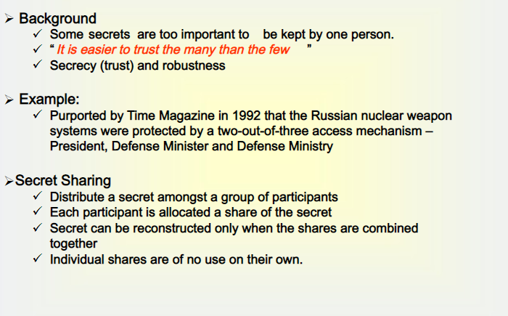
Splitting and Sharing Keys

Slide 111
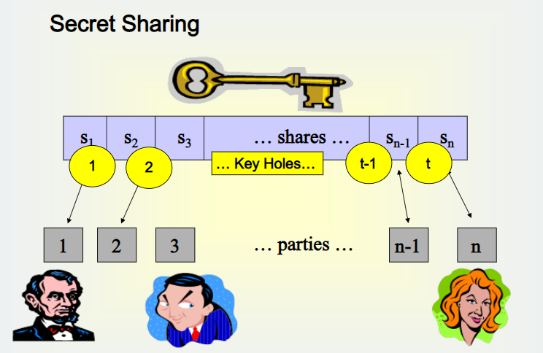
Splitting and Sharing Keys
What is secret sharing?

Slide 112
Splitting and Sharing Keys
A method of distributing data between a group of persons so that any subset of a specified size can access the data, and a subset of a size smaller can not.
Secret Sharing Schemes
A (t,w) Threshold Scheme is a method of sharing a key K among w participants in such a way that any t participants can compute the value of K, but no group of t-1 participants can.

Slide 113
Splitting and Sharing Keys
What is secret sharing? – a scenario – for understanding
Suppose you and your friend accidentally discovered a map that you believe would lead you to an island full of treasure.
You and your friend are very excited and would like to go home and get ready for the exciting journey to great fortune.
Now who is going to keep the map? Suppose you and your so-called friend do not really trust each other and are afraid that, if the other one has the map, he/she might just go alone and take everything.
Now we need a scheme that could ensure that the map is shared so that no one would be left out on this trip. What would you suggest?
An easy way to solve this problem is to split the map into two pieces and ensure that both pieces are needed to find the island.
Now we give one piece to each. You can happily go home and be assured that your friend has to go with you in order to find the island. This illustrates the basic concept of secret sharing.

Slide 114
Splitting and Sharing Keys
Example
Imagine that you have made billions of ￡$ from internet stocks and wish to leave your estate to your 4 children. You like to divide it among them in such a way that two of them have to get together to reconstruct the real combination, i.e., someone who wants some of the inheritance must somehow cooperate with one of the other children. (t,w)=(2,4) - threshold scheme.
Definition: Let t≦w be positive integers. A (t,w)-threshold scheme is a method of sharing a message M among a set of w participants such that any subset consisting of t participants can reconstruct the message M, but no subsets of smaller size can reconstruct M.

Slide 115
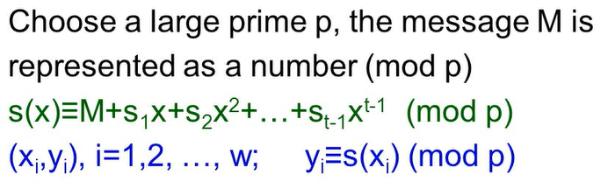
Splitting and Sharing Keys
Shamir threshold scheme in 1979 Based on Lagrange interpolation polynomials called Lagrange interpolation scheme,

Slide 116
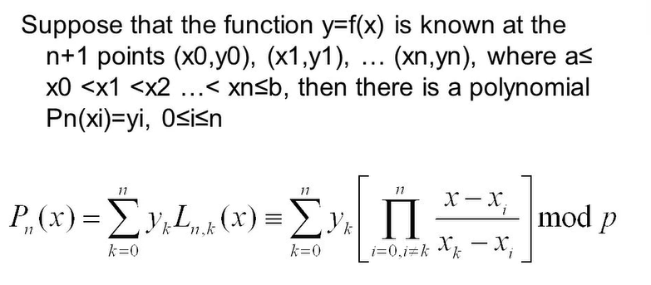
Splitting and Sharing Keys
Lagrange Interpolating Polynomials

Slide 117
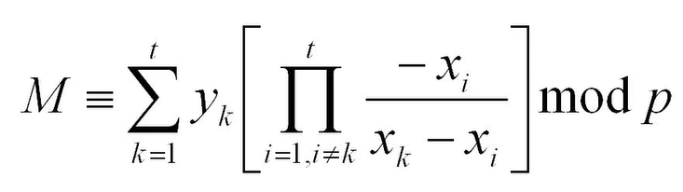
Splitting and Sharing Keys
Computing Secret Value M
Simple Exercises
You set up a (2,30) Shamir threshold scheme, working mod the prime 101. Two of the shares are (1,13) and (3,12). Another person received the share (2,*), what is the value of *?3.
In a (3,5) Shamir secret sharing scheme with modulus p=17, the following were given to Alice, Bob, and Charles: (1,8), (3,10), (5,11). Calculate the corresponding Lagrange interpolating polynomial, and identify the secret.

Slide 118
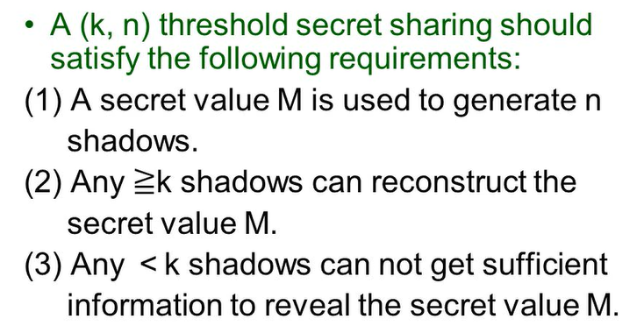
Splitting and Sharing Keys
(Secret) Value Sharing

Slide 119
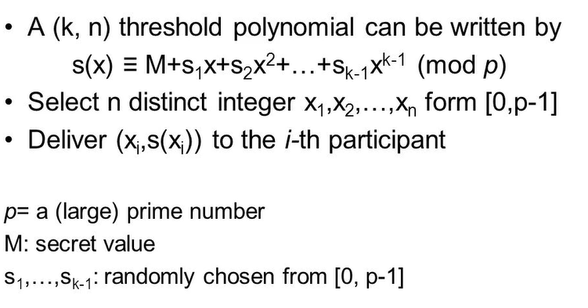
Splitting and Sharing Keys
Secret Sharing (1/4)

Slide 120
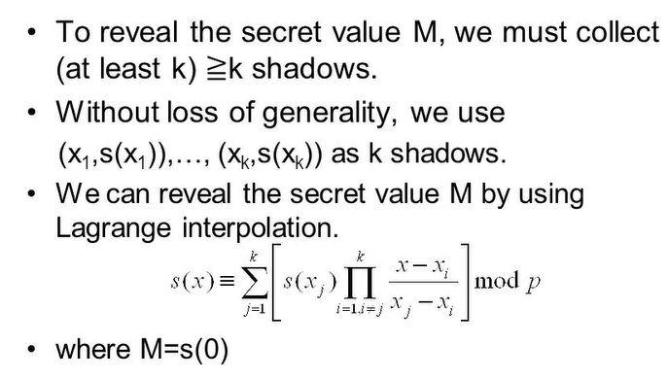
Splitting and Sharing Keys
Secret Sharing (2/4)

Slide 121
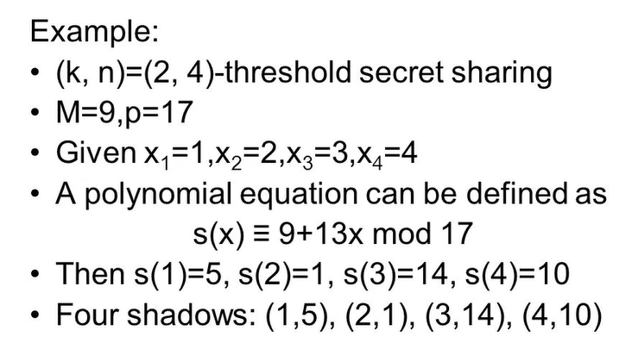
Splitting and Sharing Keys
Secret Sharing (3/4)

Slide 122
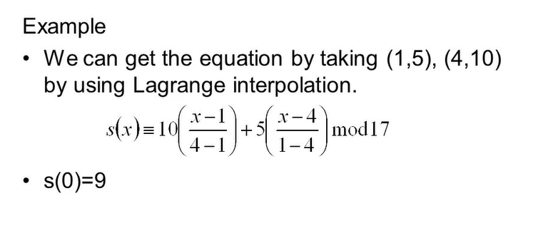
Splitting and Sharing Keys
Secret Sharing (4/4)

Slide 123
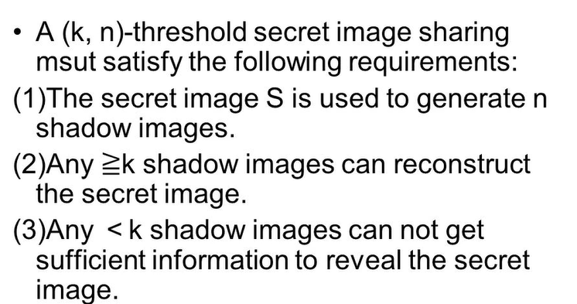
Splitting and Sharing Keys
Secret Image Sharing

Slide 124
Splitting and Sharing Keys
Until now we have talked about different ways of storing private keys in a single place. This will give us only one point of failure. Now we will see how it is possible to split and share keys to have more security.
To be able to split and share keys, we will introduce a trick called Secret Sharing.
The idea is to split the key into N pieces such that, given any K of those pieces, is possible to reconstruct the key. While having fewer than K pieces, we'll not be able to know anything about the original key.
Example with N=2, K=2
Let's see an example of how this work with N=2 and K=2.We will have to choose:
a large prime number P
S is secret and has to be in the range [0, P-1]
R a random value, which is also in the range [0, P-1]
Then we split the secret S in the following way:
X₁ = (S+R) mod P
X₂= (S+2R) mod P
If we own both X₁ and X₂, we can reconstruct S:
Reconstruction : (2X₁ - X₂) mod P = (2S+2R-S-2R) mod P = S mod P = S

Slide 125
Splitting and Sharing Keys
with only one of the two pieces, it's impossible to retrieve S.
In addition, we can't get any useful information using one of the two pieces.
In fact, (S+R) mod P can take any value in [0, P-1] equally likely.
The same is valid for (S+2R) mod P. So X₁ and X₂ look totally random.
How to increase N, with K=2?
The idea to increase the number of shares is to use a line:
Step-1: take the 2D plane with X and Y axis
Step-2: choose a random value R
Step 3:draw a line with slope R and pass through the point (0, S)
Step 4: the shares will be the points on the line (1, S+R), (2, S+2R), (3, S+3R), ...
Step 5: Clearly, it is possible to choose as many shares as wanted, since there's an infinite number of points on the line
Step 6: Given any two points on a line, it is possible to retrieve its equations using interpolation, so K=2.
Step 7: Given just one point, it's impossible to retrieve any information about the line
Step 8: If we do this operation using the arithmetic modulo a large prime P, all we have said is still applicable.

Slide 126
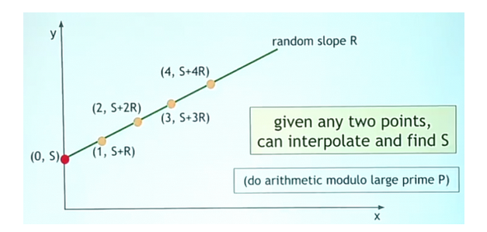
Splitting and Sharing Keys

Slide 127
Splitting and Sharing Keys
How to increase K
If we want to increase K, we can use functions that require more than two points to be defined.
For example, if we want K=3, we will use a quadratic function.
In fact, three points are necessary to define uniquely a quadratic function.
In this case, there will be two random parameters R₁ and R₂, since the equation would be:
Y = R₂ X² + R₁ X + S
We can go on like this increasing the polynomial degree.
For example, if we want K=4 we can use a cubic function with three random parameters and so on.
Every curve used has infinite points, so we can also increase N at will

Slide 128
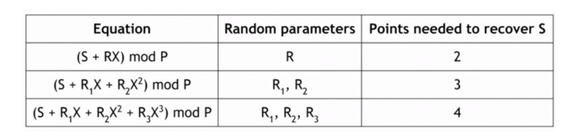
Splitting and Sharing Keys
This scheme will let you take any secret and split it into N shares, such that K shares or more are needed to retrieve it.

Slide 129
Splitting and Sharing Keys
Secret sharing Pros and Cons
What's good and bad about the scheme we've just seen? So:
good: it is possible to store the shares separately. So an adversary needs to be able to retrieve K shares in order to get back the secret key. So, he needs to break the security of different places K times. In addition, we can afford to lose some shares, since only K of them chosen randomly is needed to retrieve the key.
bad: if we want to sign a transaction, we need to reconstruct the key bringing the shares together. This is a point of vulnerability. If we get attacked at this moment the adversary can recover the full key.

Slide 130
Splitting and Sharing Keys
Example:
Breaking/Splitting
N=2, K=2, p=29, s=13, r =11
X1= (s+r) mod p (13+11) mod 29 =24
X2 = (s+2r) mod p (13+2× 11) mod 29 =6
Reconstruction:
(2×X1 - X2) mod p =s (2×24 – 6) mod 29 42 mod 29 =13

Slide 131
Secret Sharing Step-By-Step
Example Problem
To illustrate, let’s imagine that a family of four all share a single Bitcoin wallet. This Bitcoin wallet contains a single private key that all members of the family are co-own. Because there is a single key, any of the family members can use that key to spend all of the Bitcoins.
The family has a problem: If they each keep a copy, then only one of their copies needs to be compromised to have all the coins stolen. If only one of them keeps the key, then that person may lose it or decide to double-cross the other family members.
Luckily, one of the family members is also a cryptographer. Instead of innocently sharing the original key, they use SSS (Shamir’s secret sharing).
The family creates four shares and sets a threshold of three, with the Bitcoin key as the original secret.
Now, their plan has the following properties:

Slide 132
Secret Sharing Step-By-Step
Now, their plan has the following properties:
They have not stored the bitcoin key in a single place which makes it harder to steal
Members of the family need to cooperate to spend the Bitcoin, one family member can’t betray the others
If a family member dies or loses their share, the other three members can still reconstruct the key.
Understanding the Threshold
Every Shamir sharing scheme(SSS) has a total number of shares and a threshold.
The threshold is the number of shares required to reconstruct the original secret.
For example, with five shares and a threshold of three, you only need three of the five shares to calculate the original secret.

Slide 133
Secret Sharing Step-By-Step
The Math - Lines
One of the fundamental mathematical properties used in Shamir’s secret sharing is the fact that it takes k points to define a polynomial of degree k - 1.
For example:
Only one line can be drawn between two points
Only one possible parabola crosses through the same three points
Only one cubic curve passes through the same four points
An infinite number of lines can be drawn through the same point
An infinite number of parabolas can be drawn through the same two points

Slide 134
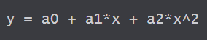
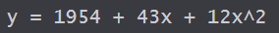
Secret Sharing Step-By-Step
The Math - Walkthrough
Let us construct a scheme to share our secret 1954 (S) with 4 (n) shares and a threshold of 3 (k).
First, we randomly choose k - 1 positive integer, so in our case, 2 positive integers.
We randomly choose 43 and 12.
Then, we build a polynomial of the form
Where a0 is the secret, and a1 and a2 are our randomly chosen integers. We are left with:
Then, we use this formula to create 4 points (shares) that we give to each participant.

Slide 135
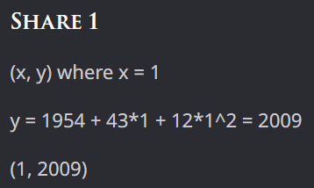
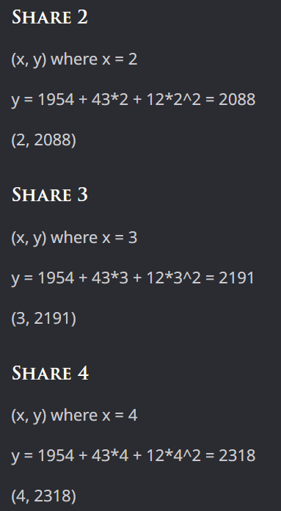
Secret Sharing Step-By-Step
.

Slide 136
Secret Sharing Step-By-Step
Reconstruction
Each participant in our scheme now owns one (x,y) point, which is a single share.
Remember that we set our threshold to 3 and that 3 points define a parabola (polynomial of degree 2) perfectly.
That means that if we use three points, we can draw a parabola and calculate a0 (the secret).
Let’s assume we have control of shares 1, 2, and 4.

Slide 137
Online Wallet and Exchanges
Online wallets
Like a local wallet “ but in the cloud”
This application will store the keys, encrypted with a password that only the owner knows, but it is necessary to trust the security of the website

Slide 138
Online Wallets and Exchanges
Online wallets​ .
An online wallet is kind of like a local wallet that you might manage yourself, except the information is stored in the cloud, and you access it using a web interface on your computer or using an app on your smartphone. Some online wallet services that are popular in early 2015 are Coinbase and blockchain.info

Slide 139
Online Wallets and Exchanges
Examples:
Coinbase: Coinbase is one of the most popular cryptocurrency exchanges in the world, with over 56 million users in over 100 countries. It allows users to buy, sell, and store cryptocurrencies like Bitcoin, Ethereum, and Litecoin.
Binance: Binance is another popular cryptocurrency exchange that offers a wide range of services, including spot and margin trading, staking, and lending. It supports over 150 cryptocurrencies, including Bitcoin, Ethereum, and Binance Coin.
Kraken: Kraken is a US-based cryptocurrency exchange that allows users to buy and sell a variety of cryptocurrencies, including Bitcoin, Ethereum, and Ripple. It also offers advanced trading features like margin trading and futures trading.

Slide 140
Online Wallets and Exchanges
Blockchain.com: Blockchain.com is a popular online wallet that allows users to store and manage their cryptocurrencies. It also offers a range of other services, including buying and selling cryptocurrencies and sending and receiving payments.
Ledger Nano S: Ledger Nano S is a hardware wallet that allows users to securely store their cryptocurrencies offline. It supports over 1,800 cryptocurrencies and allows users to manage their crypto assets using a mobile app.
Trezor: Trezor is another popular hardware wallet that offers secure storage for cryptocurrencies. It supports over 1,000 cryptocurrencies and offers advanced security features like two-factor authentication and passphrase protection.
Exodus: Exodus is a desktop and mobile wallet that allows users to store and manage their cryptocurrencies. It supports over 100 cryptocurrencies and allows users to exchange their crypto assets within the wallet.

Slide 141
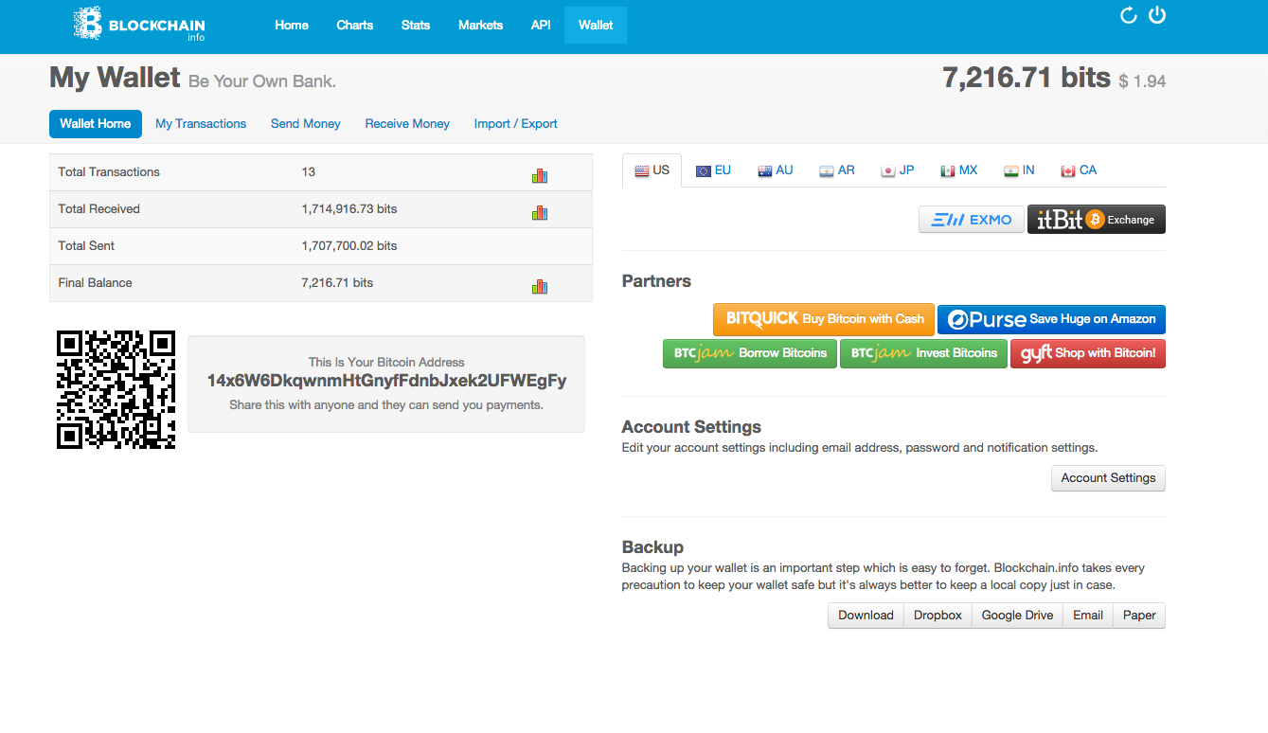

Slide 142
Advantages:
it is not necessary to install software to use a web based wallet, or a simple app on the phone
it works across multiple devices, even if a device is lost, the wallet will still be available
Disadvantages:
if the website or app is malicious or gets compromised somehow, the bitcoins can be lost. It is necessary to trust the website as more secure than oneself

Slide 143
Bitcoin Exchanges
Bitcoin exchanges are businesses that, at least from a user interface point of view, are similar to banks
accept deposits of Bitcoins and fiat currency (es. $, €, ...)
enable to send and receive Bitcoins
buy and sell Bitcoins for fiat currency. Typically they try to match Bitcoin buyers and sellers. So they find some customer who wants to buy bitcoins with dollars/euros and some other customer who wants to sell bitcoins for dollars/euros and try to match them up.

Slide 144
Exchange buy and sell process
Now let's see what happens when you buy and sell Bitcoins in an Exchange:
suppose that you own an account of 5000$ in some Exchange
you place an order for 2 Bitcoins which costs 580$ each
if the exchange finds someone who wants to sell 2 Bitcoins, it matches the two transactions
the result is that in your account now you see 3840$ and 2BTC
The important thing to note, is that the exchange doesn't need to commit an actual transaction on the blockchain. The only thing that is changed is that the Exchange now promises to you 3840$ and 2BTC. No actual movement of money through the dollar economy or Bitcoin blockchain was necessary.

Slide 145
Exchange Risks:
risk of bank run
Ponzi scheme
cyber attack

Slide 146


Slide 147
Bank Regulations
For traditional banks, the government typically:
Imposes minimum reserve requirements
Regulates behavior
Investments
Insures depositors against losses

Slide 148
Proof of Reserve – Bit coin Exchanges
To increase the customers' amount of comfort, the exchange can do some cryptographic trick called Proof of Reserve
For example it could have the 25% of the deposits, that people made, available for withdrawal
The Proof of Reserve is made of two pieces:
prove how much reserve it's holding.
prove how many demand deposits the group holds
With these two things, it is enough to divide those into numbers to obtain the amount of fractional reserve.

Slide 149
Prove the Reserve Amount:
The company publishes a valid payment-to-self transaction of that amount
For example, if it declares to own 100000 BTC, it creates a valid transaction that pays 100000 BTC to itself.
Then it signs, with the same private key used for the payment-to-self transaction, a random string generated by some impartial party
This proves that someone who knew the private key was a participant in the proof of reserve
This shows that whoever owns 100000 BTC is willing to cooperate with the process.

Slide 150
Prove the number of deposits
we use a trick related to the Merkle tree.
It's a binary tree built with hash pointers
Its pointers tell where to find the information and its hash
We can add to every hash pointer a label with the total monetary value in Bitcoin of all the things underneath that pointer in the tree
At the bottom, we can place all the customers' accounts and combine them in a Merkle tree so that the hash pointer coming out of each node is labeled with the sum of the two hash pointers below

Slide 151
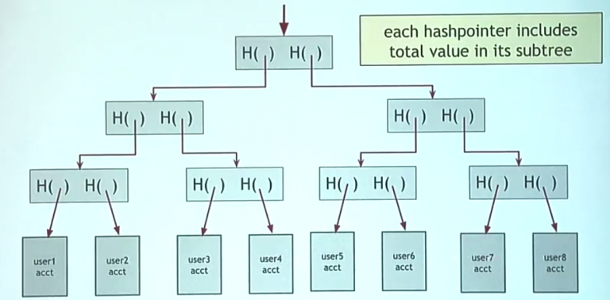

Slide 152
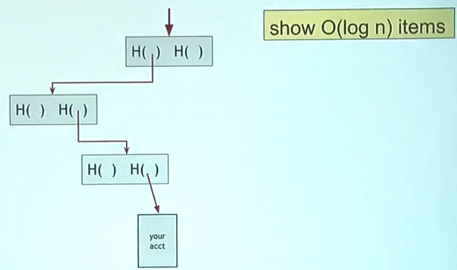
The root of the Merkle tree will correspond to the total deposit amount
The exchange can sign the root of the tree, making a claim that it's valid
Now each customer can ask to see that they are included in the tree
The exchange can show the path to the customer account and the customer can check that the hash pointers are consistent all the way down and that starting with its deposit the amount adds up to the total
If everybody does it, then every branch of the tree is explored and verified.

Slide 153
If the two pieces of proof get correctly verified, then the exchange has proven that:
they own an amount of at least X Bitcoin of reserve
the total deposits of the customers correspond to Y
So the reserve fraction would be X/Y, and it can be compared to what's declared by the company
This information can be independently verified by anybody, so it's proof that can increase the trust in the exchange.

Slide 154
Payment Services
Scenario – Merchant accepts bitcoin
Merchants want to
To receive dollars
Simple deployment
Low risk( tech risk, security risk, exchange rate risk)
The goal of payment service is to satisfy both customers and merchants to carry out their tasks with ease

Slide 155
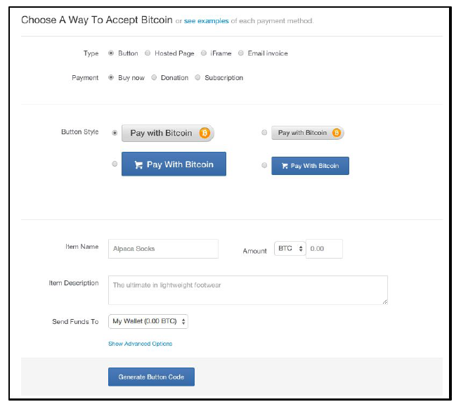
Merchant collaboration with Payment Service

Slide 156
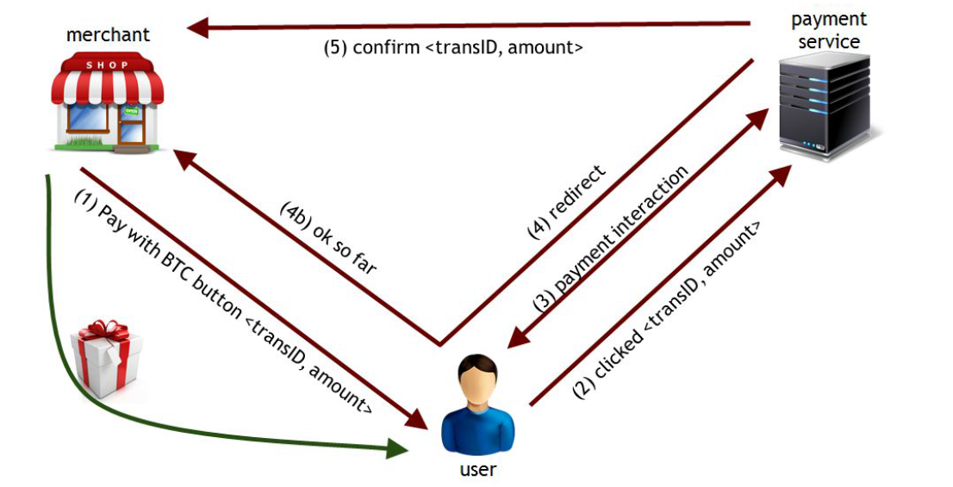
Payment process involving a user, merchant, and payment service

Slide 157
Summary
Customer: pays bitcoin
Merchant: gets dollars, minus a small percentage
Payment Service:
gets bitcoin
pays dollars ( keep a small percentage)
absorb risk ( security, exchange rate)
need to exchange bitcoins in dollars, in volume

Slide 158
Transaction Fees
It cost resources for
Peers to relay your transaction
Miners to record your transaction
Transaction fees compensate for some of these costs
Generally, a higher fee means and the transaction will be forwarded and recorded faster
Transaction fee= value of inputs – the value of outputs
This fee goes to the miner who records the transaction
a transaction fee is just defined to be the difference between the total value of coins that go into a transaction minus the total value of coins that come out
https://www.youtube.com/watch?v=DWq5jdyRAAs

Slide 159
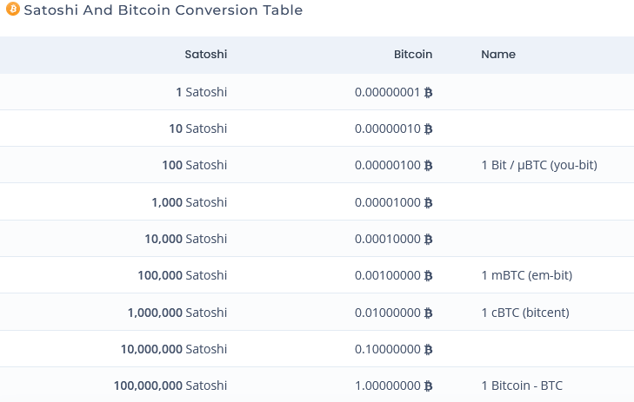
Satoshi
One Satoshi is the smallest unit of Bitcoin, each Bitcoin is divisible to the 8th decimal place, so each Bitcoin can be split into 100,000,000 units. Each unit of bitcoin, or 0.00000001 bitcoin, is a Satoshi.

Slide 160
How are transaction fee set today?
no fee if:
the transaction is less than 1000bytes in total size
all the outputs of the transaction are > 0.01 BTC
The priority of the transaction is large enough, where
Priority = (input_age₁ * input_value₁ + input_age₂ * input_value₂ + ... + input_age_{N} * input_value_{N}) / transaction_size
A fee of 0.0001 Bitcoins for every 1000 Bytes of the transaction
The transaction size is approximately 148 bytes per each input plus about 34 bytes per each output plus about 10 bytes for other information

Slide 161
Most miners enforce the consensus fee structure.
If you don’t pay the consensus fee, your transaction will take longer to be recorded
Miners prioritize transactions based on fees and the priority formula
Wallet software and payment exchanges include the consensus fee structure for every bitcoin involved transaction

Slide 162
Currency Exchange Markets
The currency exchange markets are places where it is possible to trade Bitcoins against fiat currency.
We have already seen things about exchanges where Bitcoins can be bought. But now we will see in detail the extent of this market, how it operates, and its economics.
Such in the market between dollars and euros, the price will fluctuate back and forth depending on how many people want to buy dollars for euros or vice versa.
There are websites such as Bitcoin charts, which show exchanges that trade dollars against BitCoins. There's a list of different exchange prices. It is possible to see the latest prices, the average, and the highest and lower values ever reached.

Slide 163

Currency Exchange Markets
From this list, it is possible to see that there's a lot of trading and see the prices changing in real time. There are plenty of places you can go and buy or sell Bitcoins.

Slide 164

Directly meet people who want to buy or sell Bitcoins
Here are other websites that help you meet people to trade Bitcoins in real life, for example localbitcoins.com. It is possible to set the fiat currency to exchange in Bitcoins, the area (i.e. Princeton, New Jersey, United States).

Slide 165
Directly meet people who want to buy or sell Bitcoins
There's a list of people willing to sell Bitcoins for a specific price. It is possible to contact them and arrange a meeting in a coffee shop somewhere or in a park and receive Bitcoins in exchange for dollars.
There are also physical places in the world where it's known that people go to trade Bitcoins. For example certain parks, and street corners where on particular days you know that people will be standing around to sell or buy Bitcoins.

Slide 166
Directly meet people who want to buy or sell Bitcoins
Basic Bitcoin market dynamics

